Slide 1
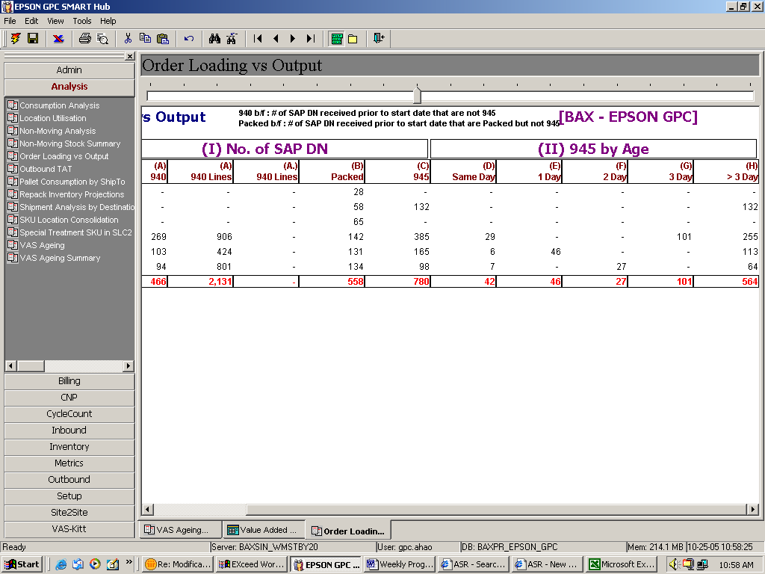
Pls add 4 more columns – refer slide no. 2

Slide 2
